Slide 1
Optimizing RIDE Sharing allocation
Analysis on Ridership Allocation for Transportation Network Providers (Uber/Lyft/Via, etc.)
Presented by:
Duo zhou, Amily huang, bowen zhao, Yiheng Zhu

Slide 2
Executive Summary
Our goal is to optimize vehicle allocation according to ridership demand and give business insights and recommendations to TNP companies(also called rider sharing companies like Uber, Lyft and Via).
We are going to use data regarding weather, major events, public safety, and census to analyze user behavior and to give precise recommendations.
We will create a relational database system that can efficiently load, store, and extract data from different sources for analysis.
Notes:
which is essential to the success of Transportation Network Providers (TNP) (Rideshare Companies)
Ridership demand can be greatly affected by, and many other factors.

Slide 3
Business Use Case
Actor | Incentive | Business Use
TNP | Understand customer behavior better Optimize vehicle allocation Improve customer service management | Understand how different factors impact ridership
Driver | Maximize income per unit time | Understand how tips vary in different circumstances
Customer | Time-efficient and safer service | Satisfy customer experience with better vehicle allocation and customer service
Notes:
TNP can utilize our analysis to optimize their vehicle allocation system according to various factors.
TNP can use our analysis to better understand customer behavior based on various factors.
Drivers can use our analysis to find locations where ridership demand is high and customers tip very generously.
TNP can further increase the maximum wait time for locations that have high crime rate. Which can greatly benefit customers

Slide 4





Solution overview: Data / Tools
Main dataset:
Data Processing:
Visualizations:
Transportation Network Providers – Trips by Location, Distance, Day/Time, Tips, etc.
https://data.cityofchicago.org/Transportation/Transportation-Network-Providers-Trips/m6dm-c72p
Tablaue
Python:
Matplotlib
Seaborn
ggplot
Plotly
Python
- Data Cleaning and Processing
Excel
- Data Cleaning and Processing
UChicago RCC
- Cloud Computing for Large Datasets
Data Connectors:
Supporting dataset:
Weather
– Historical Weather Conditions, Short-term Forecasts
https://www.ncdc.noaa.gov/cdo-web/datasets
CSV Extracts
Python
- WebScraping
NoAA
- API
Geography
– Community area boundaries in Chicago
https://data.cityofchicago.org/Facilities-Geographic-Boundaries/Boundaries-Community-Areas-current-/cauq-8yn6
Analytics:
Sports Event
– Chicago sports team (NBA,NFL,MLB) schedules
https://www.espn.com
Python:
Data Analysis
Census & Crime
https://datahub.cmap.illinois.gov/dataset/community-data-snapshots-raw-data
https://data.cityofchicago.org/Public-Safety/Crimes-2001-to-present/ijzp-q8t2

Slide 5
DATA PREPARATION
DATA SOURCE

Slide 6
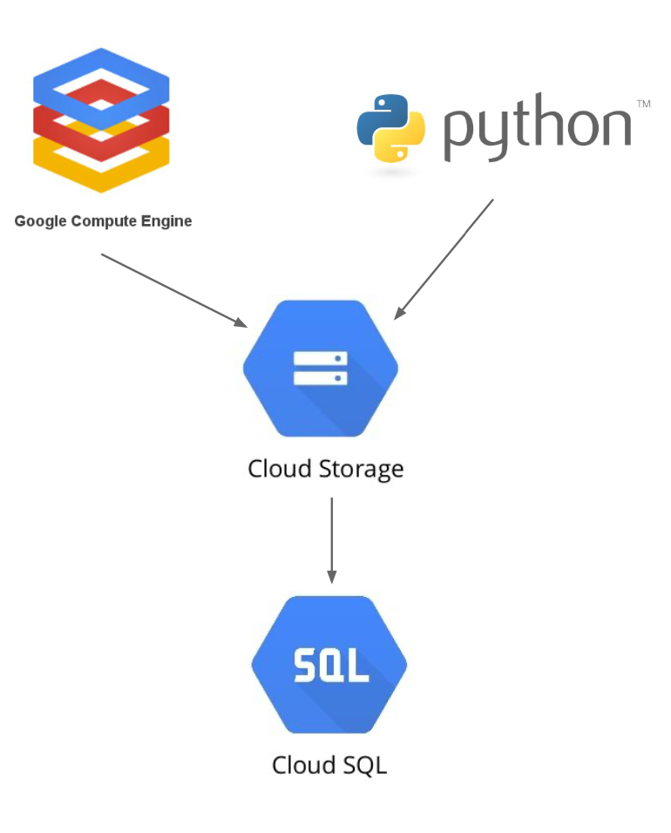
DATA MODELING
platform considerations
After scraping, we compiled the data into tables, forming the basis of an entity relationship model.
▹ Once keys were set, we were then able to create a dimensional model.
▹ We wanted to analyze movie performance and other attributes, comparing
to their source books: three main tables were created:
Movie Book Table(List of movies that were adapted from books and the book titles
Movie Table (Director, Rating, Genre, Release Year)
Book Table (Author, Rating, Genre, Publication Date)
Further we also wanted to explore relationship between individuals involved in these projects: a personnel table was created.

Slide 7
DESIGN CONSIDERATIONS
Data type for Movie ID, Person ID and Movie_Book_Id was defined as INT. Data type for movie ratings and book ratings are defined as string
▹ Movie Rating may have NA
Data type for movie air date was also defined as string ▹ Movie release date may also have the country of release along with the
date.

Slide 8
Enhanced Entity Relationship diagram

